Slide 1
TCP协议的拥塞控制机制观察

Slide 2

Hello!
I am Fang Yuchu
You can contact me at:
fangyuchu@qq.com

Slide 3
Congratulations!!!

Slide 4
One last simple experiment!!!

Slide 5
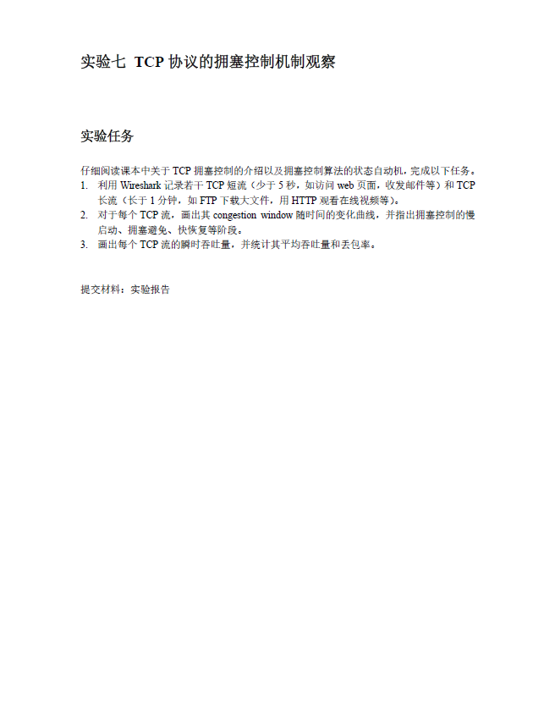

Slide 6
One last simple experiment!!!

Slide 7
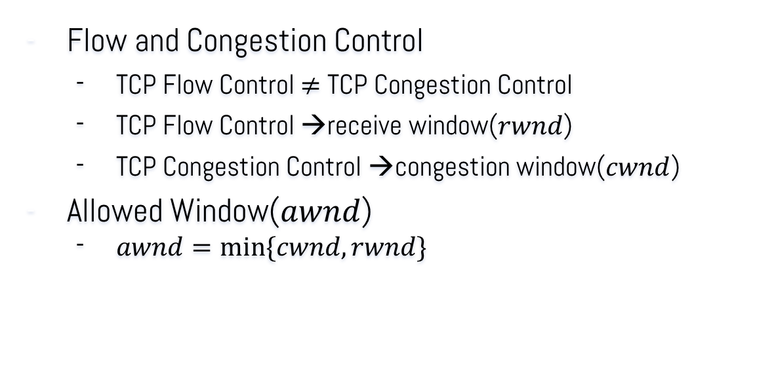
TCP Congestion Control
Flow and Congestion Control
TCP Flow Control $≠$ TCP Congestion Control
TCP Flow Control →receive window($rwnd$)
TCP Congestion Control →congestion window($cwnd$)
Allowed Window($awnd$)
$awnd=min⁡\{cwnd,rwnd\}$
usually very big
Notes:
顺序暂定

Slide 8

TCP Congestion Control
Allowed Window($awnd$)
in reality
$awnd≈cwnd$
$≈num of packets not acknowledged$
Notes:
顺序暂定

Slide 9
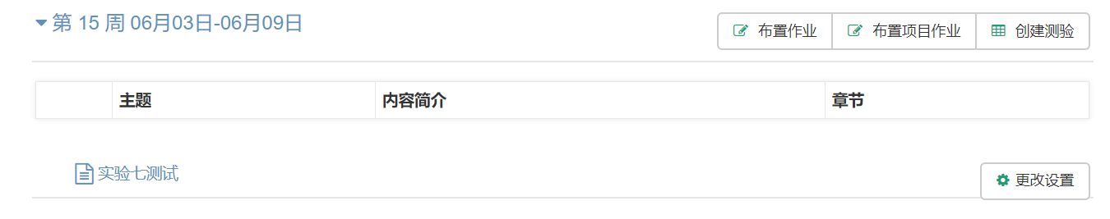
TCP Congestion Control
Experiment
One idea:
Try to count the max_num of unacknowledged packets
Where to capture the packets?
Sender? Receiver?
Ex. Capture packets when uploading a file.
Notes:
顺序暂定

Slide 10

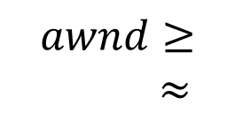
sender | receiver
1
2
 | 3
4
5
6
 | 7
ack
Time
$$awnd≥$$
$≈$
ack
Notes:
顺序暂定

Slide 11

sender | receiver
1
2
 | 3
4
5
6
 | 7
ack
Time
$$cwnd≈$$
ack
Notes:
顺序暂定

Slide 12
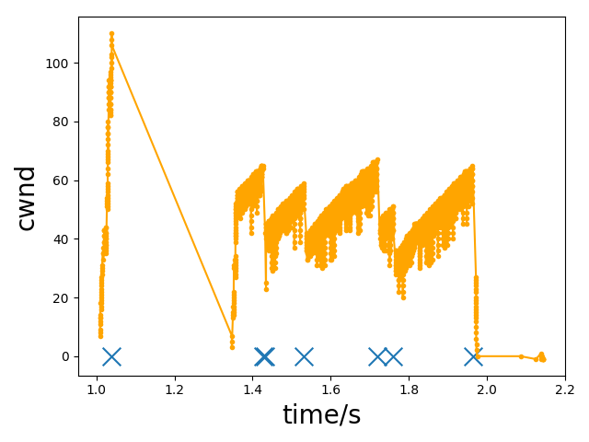
Result
Dup Ack
Notes:
顺序暂定

Slide 13
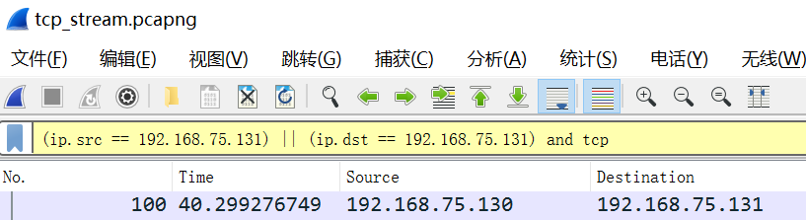
TCP Congestion Control
Some things that may help you
Notes:
顺序暂定

Slide 14
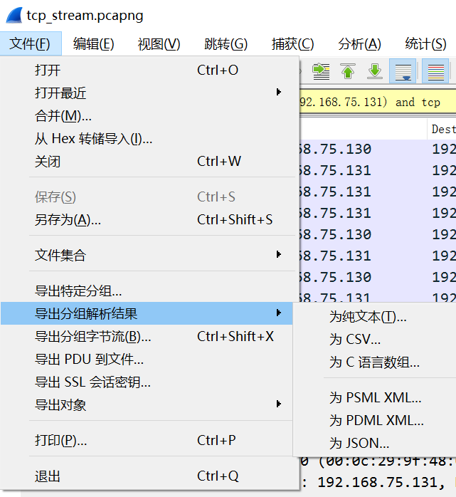
TCP Congestion Control
Some things that may help you
Notes:
顺序暂定

Slide 15
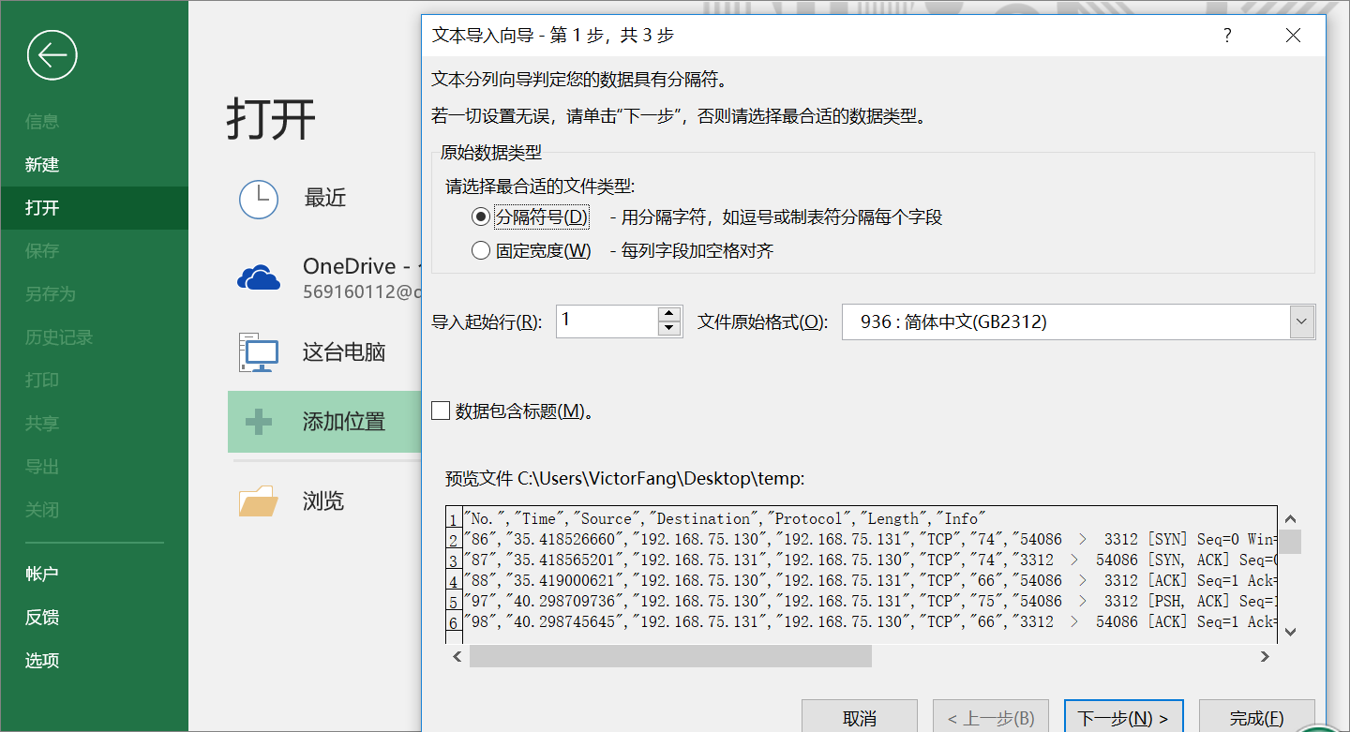
Notes:
顺序暂定

Slide 16
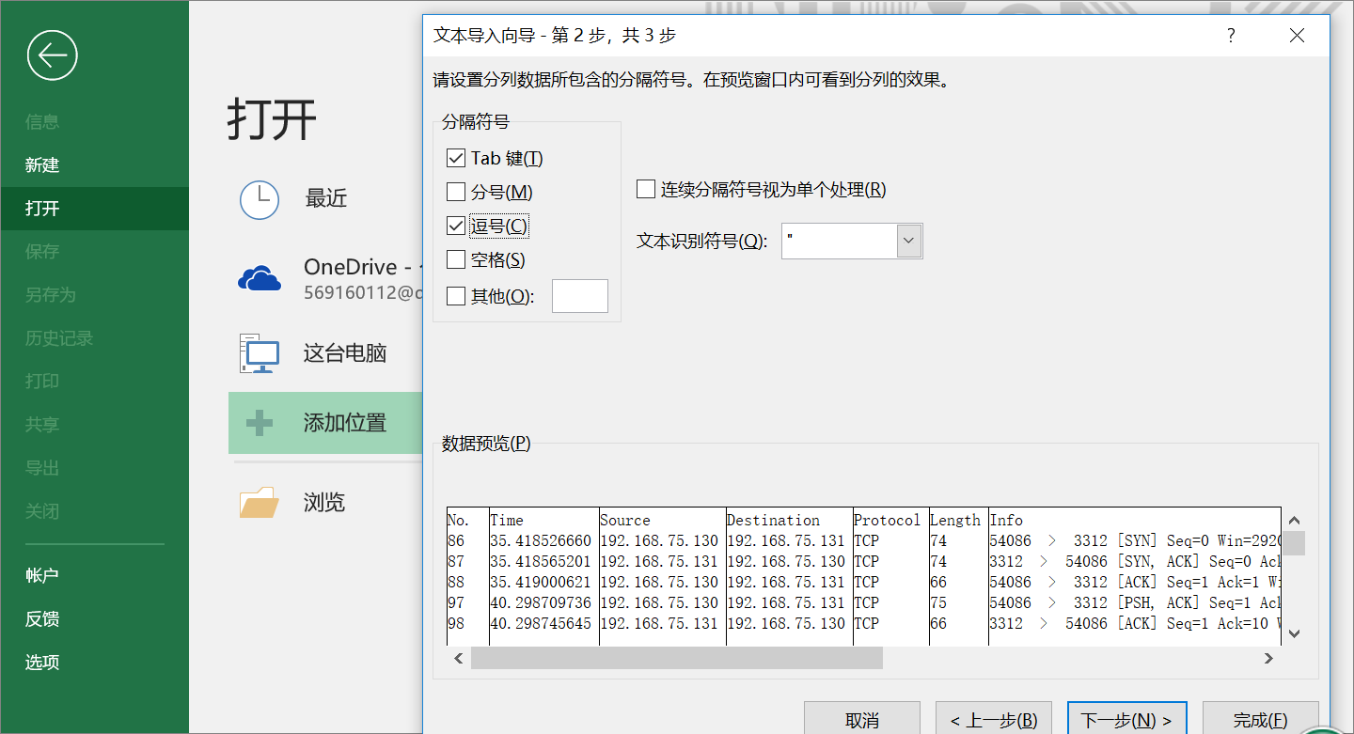
Notes:
顺序暂定

Slide 17
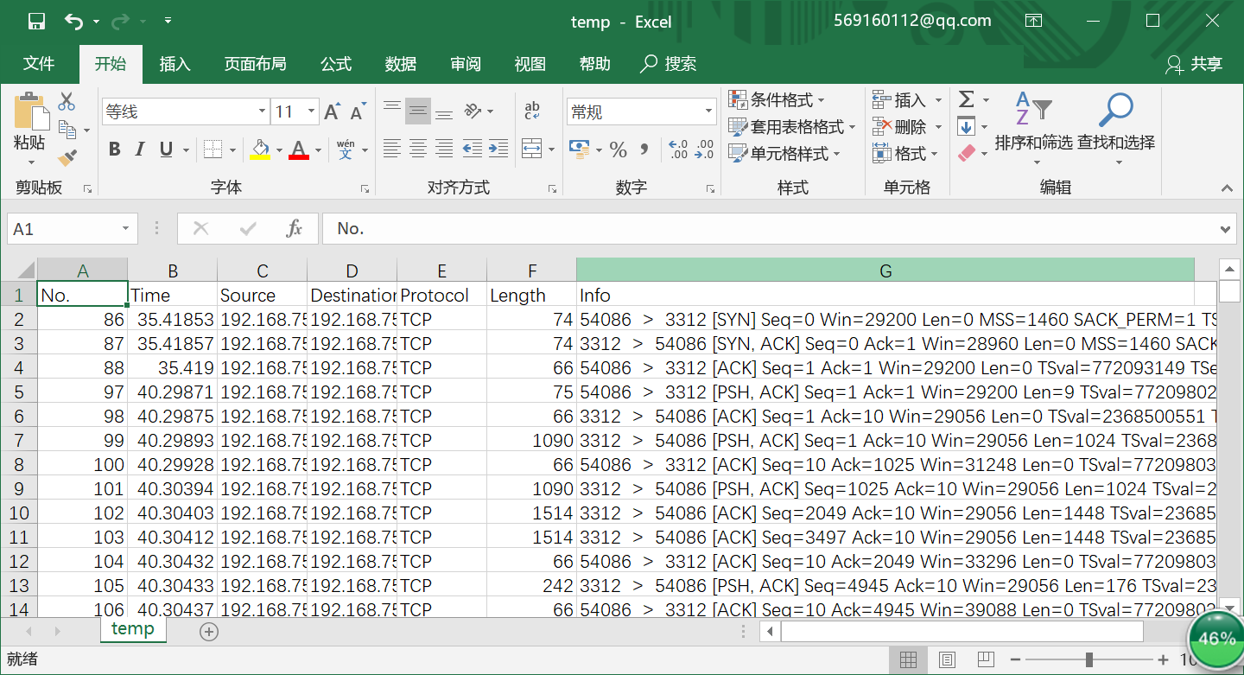
Notes:
顺序暂定

Slide 18
TCP Congestion Control
Tips
Programming language
C, C++, Python, Matlab, anything
Figure out the whole algorithm
Search the Internet
Looking forward to better ideas…
Notes:
顺序暂定

Slide 19
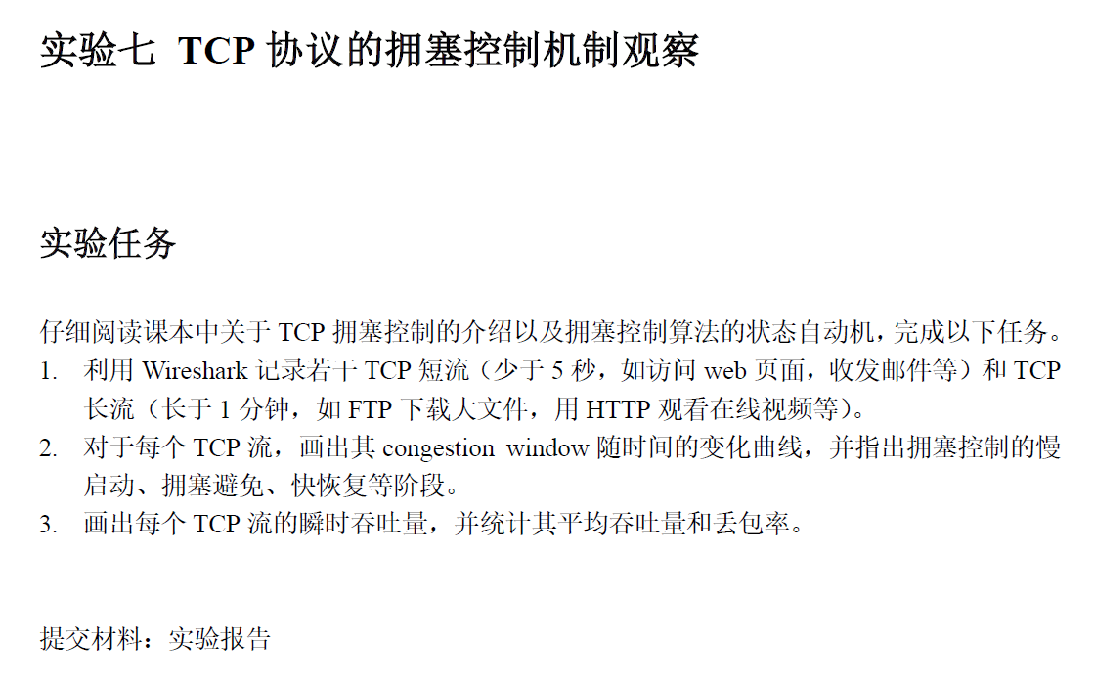

Slide 20
Thanks!

